Slide 1


Using HydroServer Organize, Manage, and Publish Your Data
CUAHSI
HIS
Sharing hydrologic data
http://his.cuahsi.org/
Jeffery S. Horsburgh
David G. Tarboton, Kimberly A. T. Schreuders, David R. Maidment, Ilya Zaslavsky, and David Valentine
And the Rest of the CUAHSI HIS Team
Support
EAR 0622374

Slide 2
In this Presentation
GOAL: Publish observational and GIS data for the Little Bear River using HydroServer in about an hour.
HydroServer Base Machine
http://sandbox08.uwrl.usu.edu
Windows Server 2008
Microsoft SQL Server 2008
ArcGIS Server 9.3.1
All HydroServer Software (ODM Tools and data loaders)

Slide 3
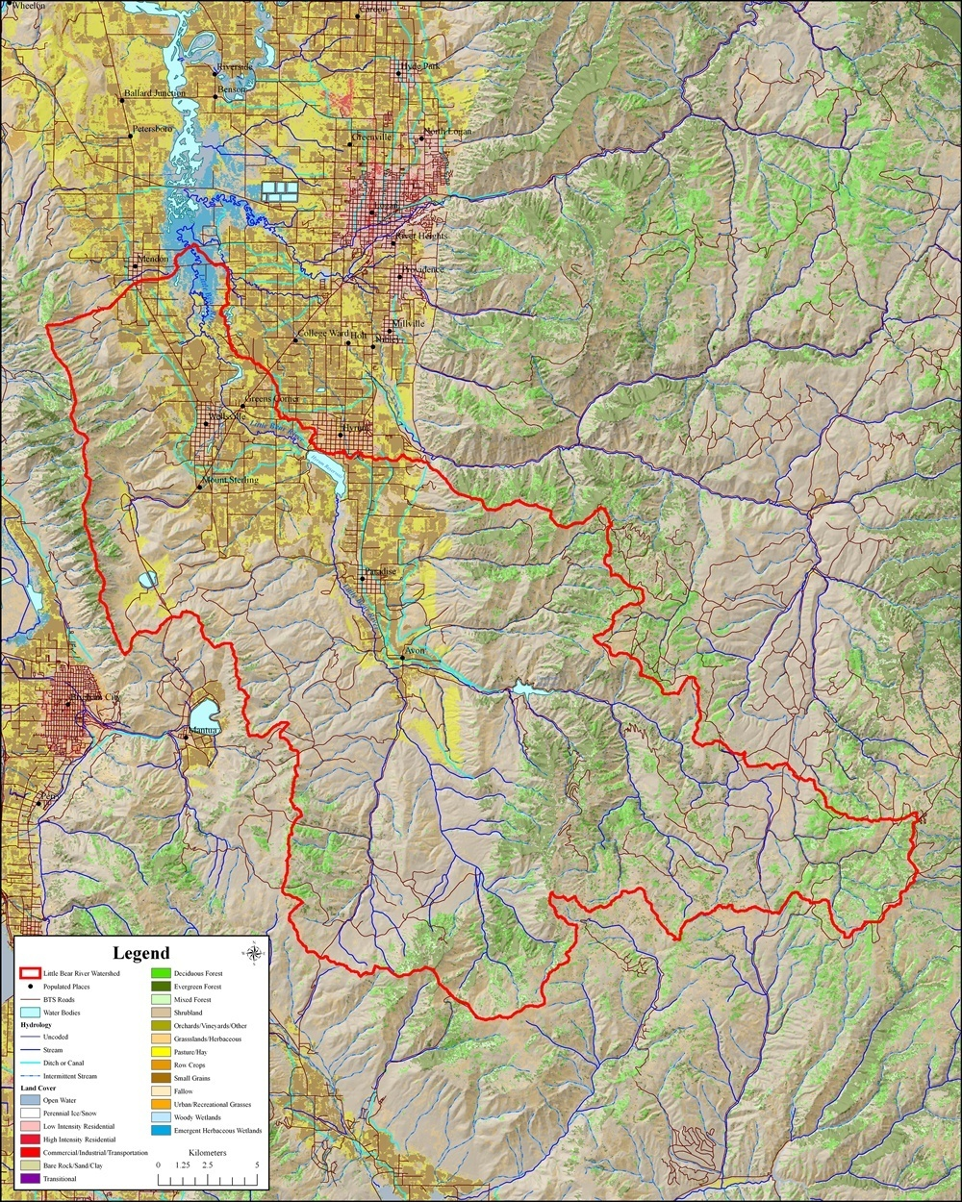
Little Bear River Experimental Watershed
Observing infrastructure for high frequency estimation of total phosphorus fluxes
High frequency surrogate measurements
Turbidity → TSS or TP

Slide 4
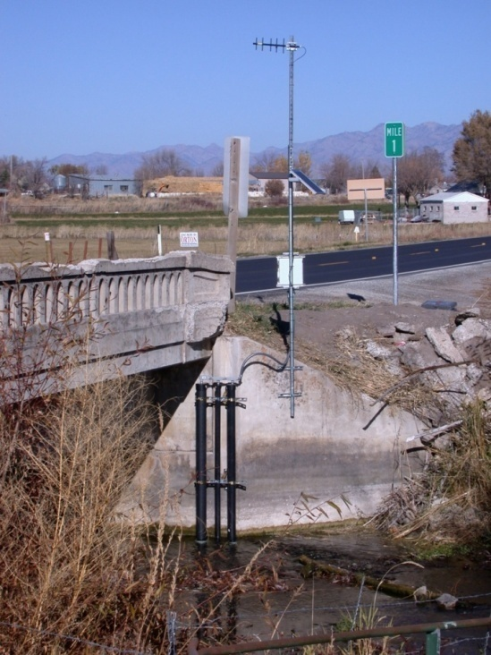
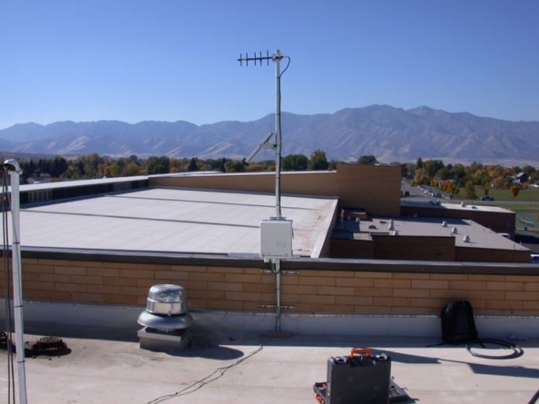
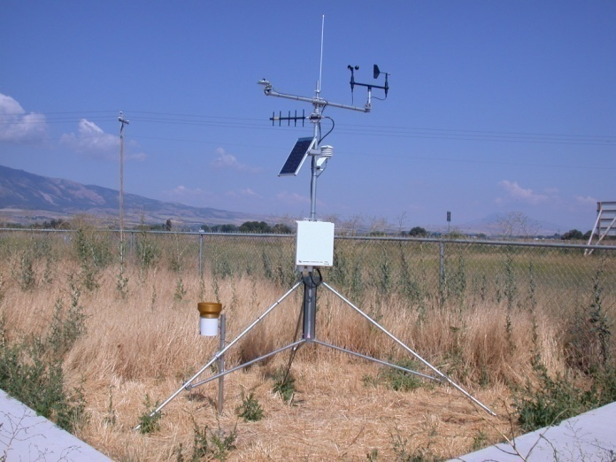
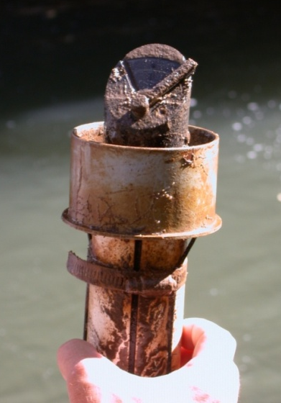



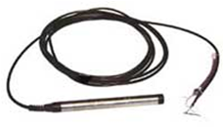
Little Bear River Sensor Network
7 water quality and streamflow monitoring sites
Temperature
Dissolved Oxygen
pH
Specific Conductance
Turbidity
Water level/discharge
2 weather stations
Temperature
Relative Humidity
Solar radiation
Precipitation
Barometric Pressure
Wind speed and direction
Spread spectrum radio telemetry network

Slide 5
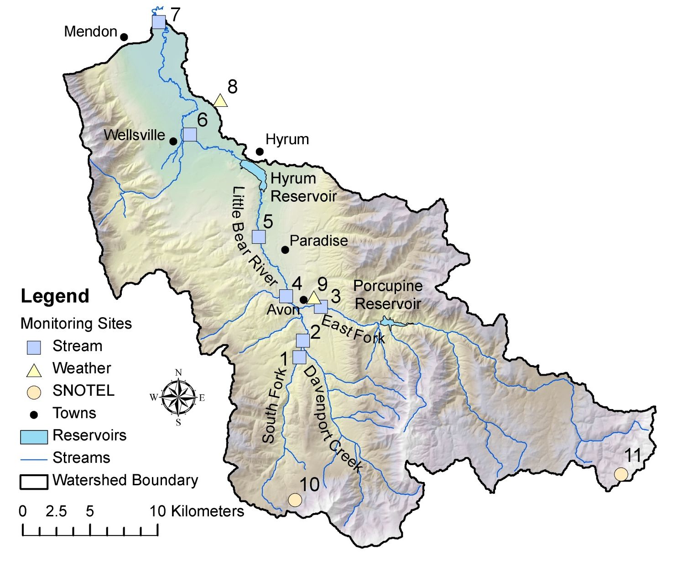
Little Bear River Sensor Network

Slide 6
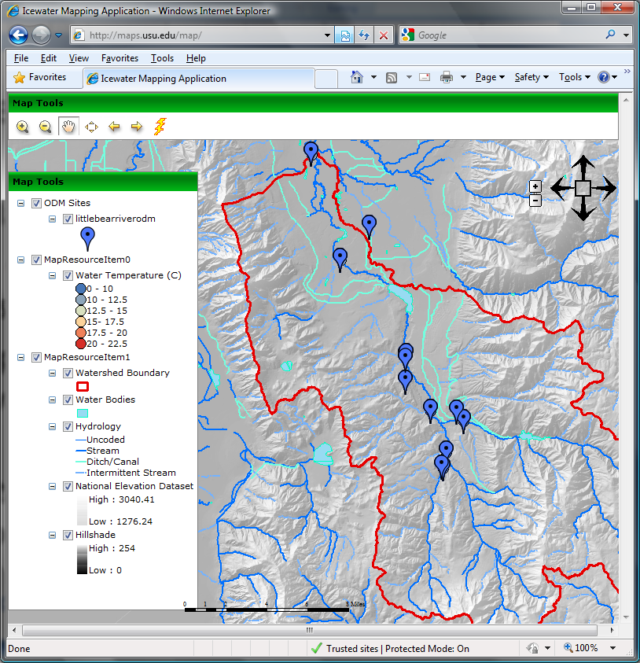
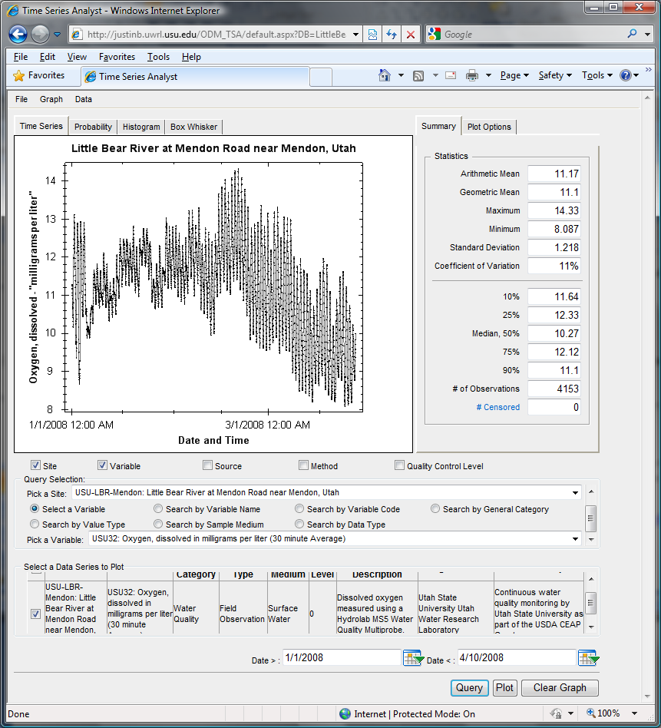
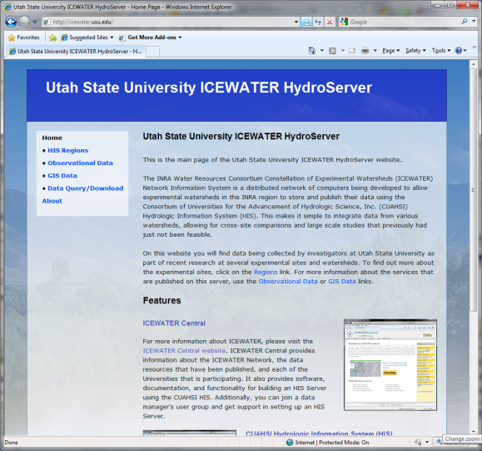
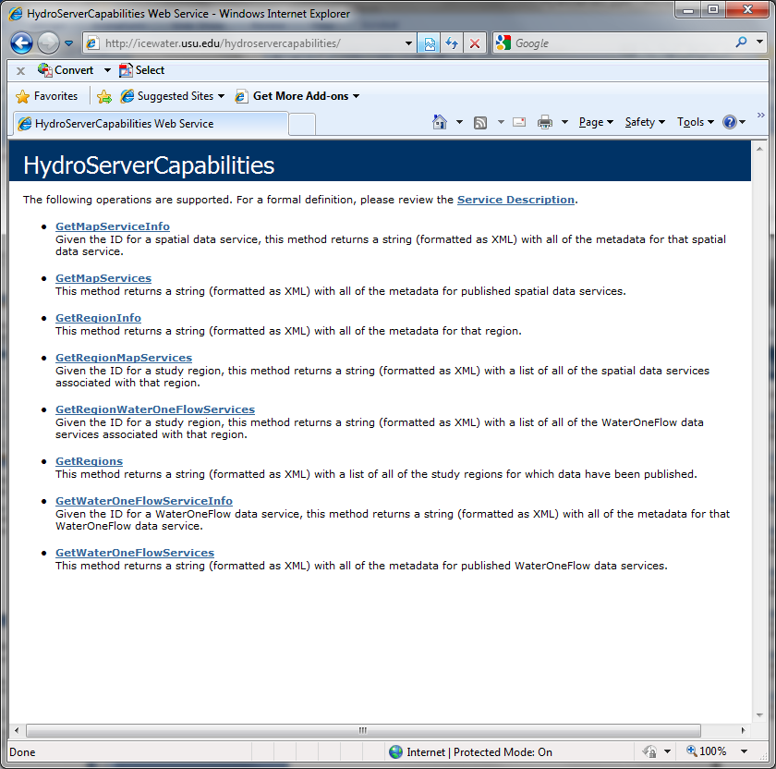
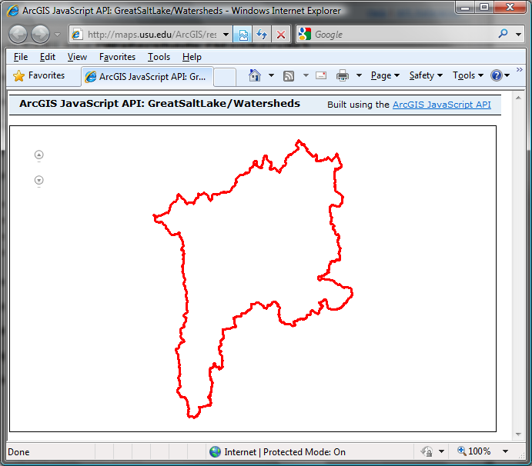
Capabilities Database Configuration Tool
WaterOneFlow
Services
HydroServer
Capabilities
Database
Spatial
Services
WaterOneFlow
WaterOneFlow
WaterOneFlow
ODM
ODM
ODM
ODM Databases and Web Services
ArcGIS Server Spatial Data Services

Slide 7
Capabilities Database Configuration Tool
WaterOneFlow
Services
HydroServer
Capabilities
Database
Spatial
Services
Publish Point Observations
WaterOneFlow
WaterOneFlow
WaterOneFlow
ODM
ODM
ODM
ODM Databases and Web Services
ArcGIS Server Spatial Data Services

Slide 8
Demo: Publish Point Observations
Create an ODM database
Organize the data by loading them into the ODM database
Manage the data using ODM Tools
Publish the data by creating a WaterOneFlow web service
Register the Service at HIS Central

Slide 9
Capabilities Database Configuration Tool
WaterOneFlow
Services
HydroServer
Capabilities
Database
Spatial
Services
Publish Spatial Data
WaterOneFlow
WaterOneFlow
WaterOneFlow
ODM
ODM
ODM
ODM Databases and Web Services
ArcGIS Server Spatial Data Services

Slide 10
Demo: Publish GIS Data
Create an ArcMap document for a set of spatial layers
Publish the ArcMap document as a spatial data service using ArcGIS Server

Slide 11
Publish HydroServer Capabilities
Capabilities Database Configuration Tool
WaterOneFlow
Services
HydroServer
Capabilities
Database
Spatial
Services
WaterOneFlow
WaterOneFlow
WaterOneFlow
ODM
ODM
ODM
ODM Databases and Web Services
ArcGIS Server Spatial Data Services

Slide 12
Demo: Publish HydroServer Capabilities
Create a HydroServer Capabilities Database
Create a “region” for the Little Bear River
Describe the observational data service and the GIS data service in the Capabilities database
Configure the HydroServer Capabilities web service

Slide 13
Create HydroServer Web Applications
Capabilities Database Configuration Tool
WaterOneFlow
Services
HydroServer
Capabilities
Database
Spatial
Services
WaterOneFlow
WaterOneFlow
WaterOneFlow
ODM
ODM
ODM
ODM Databases and Web Services
ArcGIS Server Spatial Data Services

Slide 14
Demo: Create HydroServer Web Applications
Configure the HydroServer Time Series Analyst
Configure the HydroServer Map
Configure the HydroServer Website

Slide 15
Questions?
CUAHSI
HIS
Sharing hydrologic data
http://his.cuahsi.org/
Support
EAR 0622374

